Slide 1



CADCA 2024
Community Based
Advocacy Focused
Data Driven
Coalition Building
Association

Slide 2


Sober Life, Safer Roads
Innovations in preventing substance use and impaired driving among youth
Objectives of this Presentation -
  Learn key facts about the problem of substance use and impaired driving
  Understand the research basis for effective strategies for preventing substance use and impaired driving
  Describe effective educational strategies to engage teens and prevent substance use and impaired driving.
Rebecca Stelter
Research Scientist II
Innovation Research and Training

Slide 3
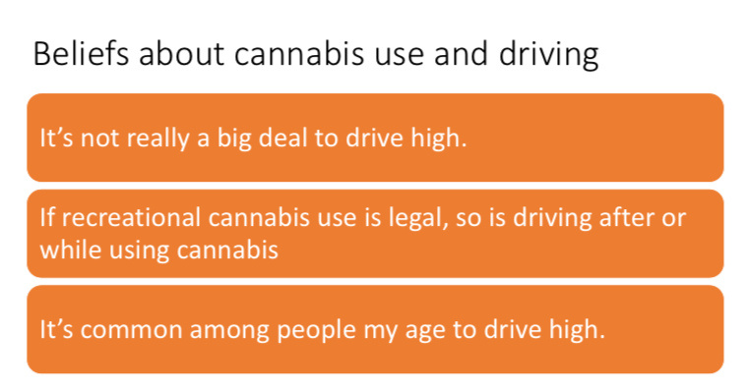
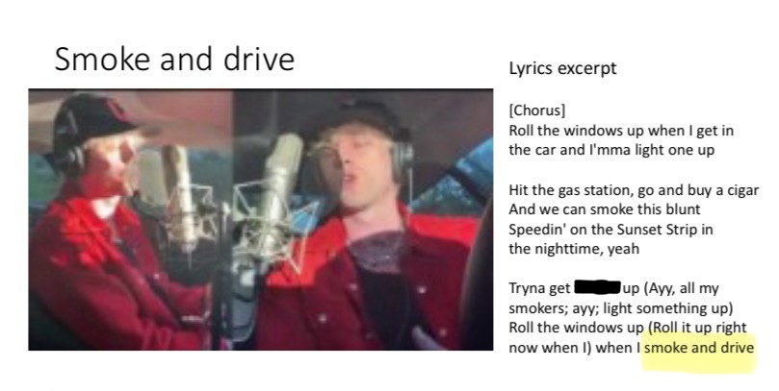
THC/Marijuana use and driving -
Common Misconceptions and glorification

Slide 4
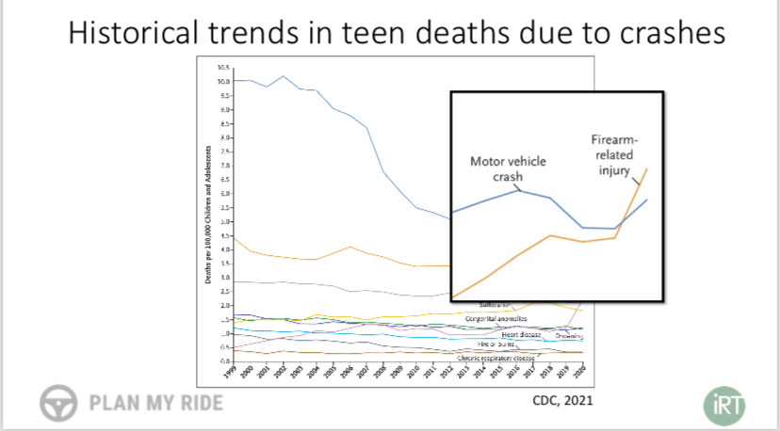
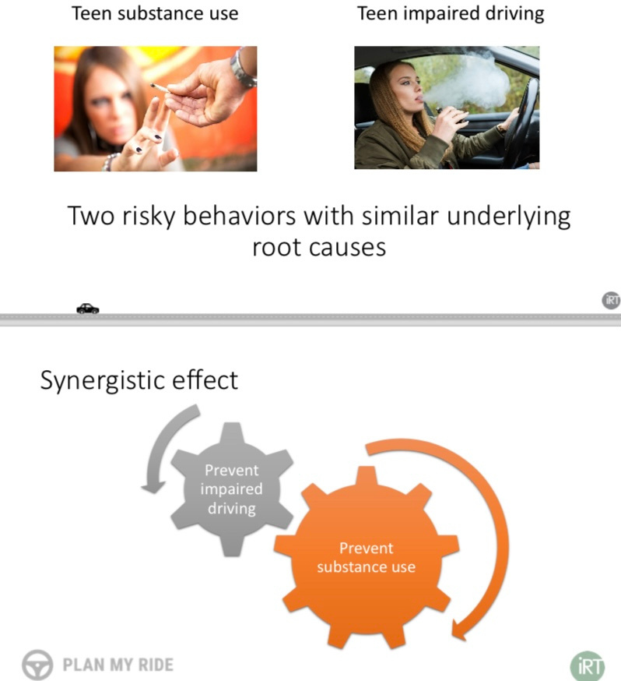
Motor vehicle crashes are the leading cause of death among teens and young adults
Teen Death Due to Car Crash is on the rise for the first time in decades.

Slide 5
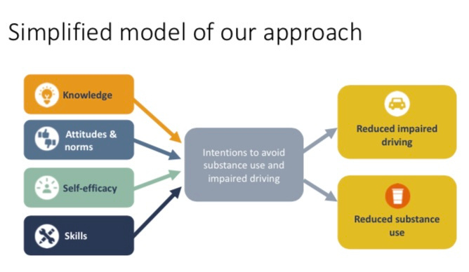
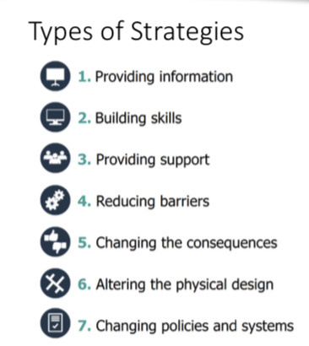
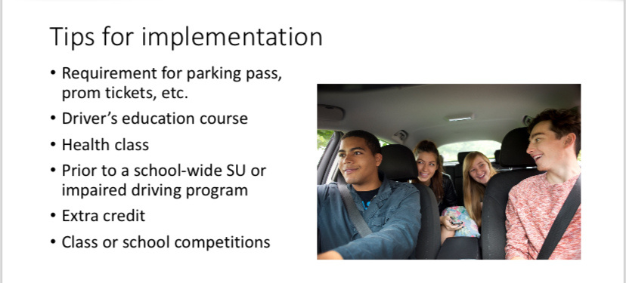
Addressing the problem from different angles
Unsafe driving and substance use are two high risk behaviors in teens and young adults that can be addressed together using existing theories.

Slide 6


OPERATION PARENT
MISSION: TO LOVE AND SUPPORT PARENTS BY PROVIDING REAL WORLD INFORMATION, CONNECTION, AND HOPE.
Jean, Kelli, Nickie
RECOGNIZED THE NEED TO GET REAL FACTS OUT TO PARENTS ABOUT PREVENTION SO THEY TOOK IT ON THEMSELVES.

Slide 7



Free Resources

Slide 8
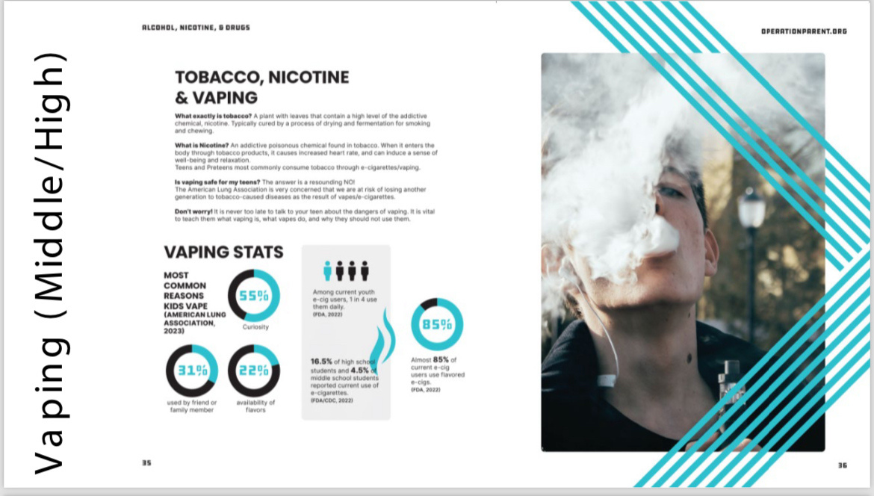
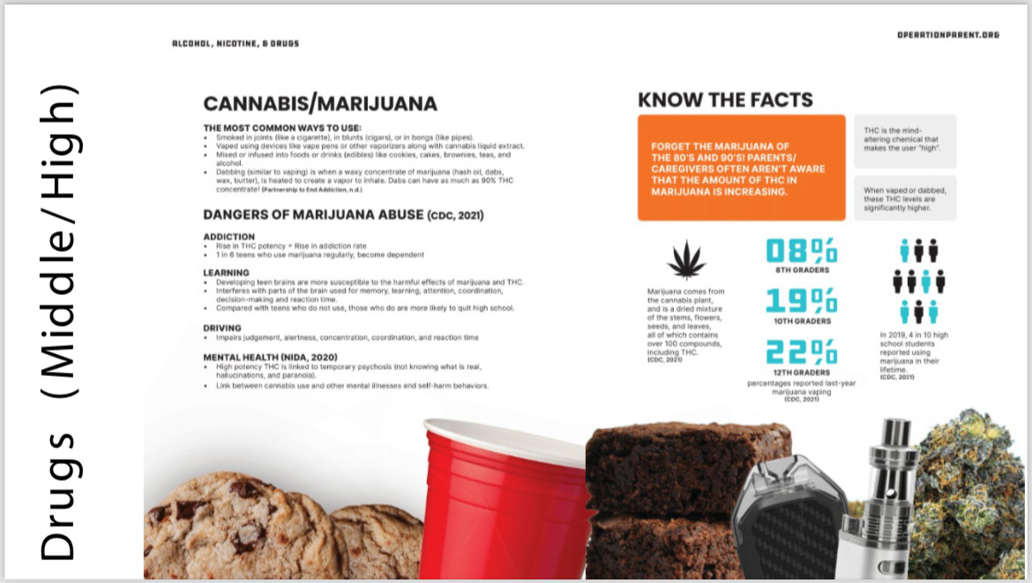

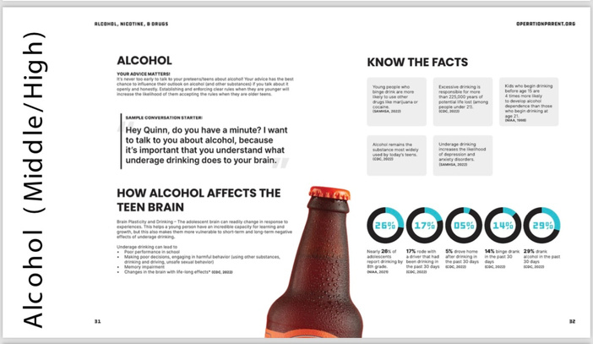
operationparent.org.
Smart Home Platform
The product category that
we serve as an alternative is
offered. However, what we
offer must relate to one
another in solving society
and market problems.

Slide 9


Cannabis Prevention
in the Era of
Commercialization
The Issues Impacting Youth

Slide 10

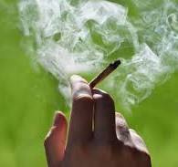
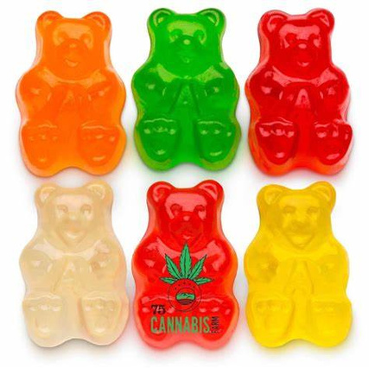
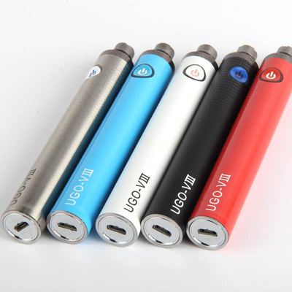
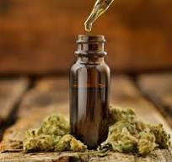
High Potency THC Comes in Many Different Forms
Edibles
Smokeables
Vapes
Tinctures
*Current research suggests escalation of risks to physical and mental health is with products of potencies over 10 percent

Slide 11

Cannabis
And the Adolescent Brain
  Poor Academic performance
  Deficits in attention, information processing and memory.
  Increase risk of developing schizophrenia and other psychoses.
  Increase incidence of suicidal ideation and attempts.
  Increase of social anxiety disorders
  Changes in brain size, either smaller or larger.
  Impaired nerve connections in the brain

Slide 12


Risk Factors
Protective Factors
Perception of peer use
Parental disapproval
Low perception of harm
Parental attachement
Availability
Parental Communication
Social norms favorable to use
Peer disapproval of use
Exposure to advertising
Education

Slide 13


Fentanyl, Here Is Where You Start
Guide to Community Prevention, Lesley Gable and Erin Cohen

Slide 14

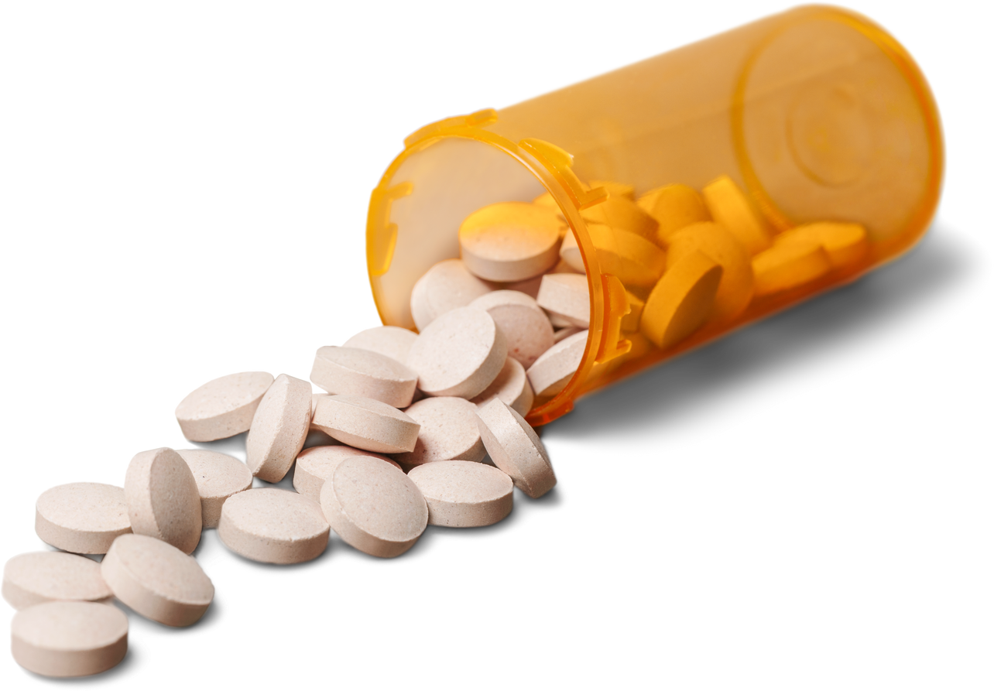
  Every 5 minutes someone in this country dies from a preventable overdose.
  Fentanyl has become the primary drug threat in the Southwestern states.
  DEA Lab testing revealed in 2023 that 7 out of every 10 pills with fentanyl contain a legal dose.
  In 2022, the DEA seized more than 60 million fentanyl-laced fake pills which is equivalent to more than 397 million lethal doses, enough to kill everyone in the United States.
Sobering
Stats

Slide 15
SOLUTIONS
  Use faith communities to promote the drug take-back days *NATIONAL PRESCRIPTION TAKE-BACK DAY IS APRIL 27, 2024*
  Use Virtual Naloxone trainings (Youth Council is doing!)
  Put Narcan in AED boxes and around town with 24 hour access
  Use advertising on the radio to educate about the dangers
( Youth Council is doing!)
  Naloxone at First Aid Boxes at schools (Great job ACYC partners!)
  Create a Help App with resource numbers and an Anonymous Tip App so students can report to admin
  Provide trivia in waiting rooms in our communities
  Increase access to MOUDS (Medications for Opioid Use Disorders)

Slide 16
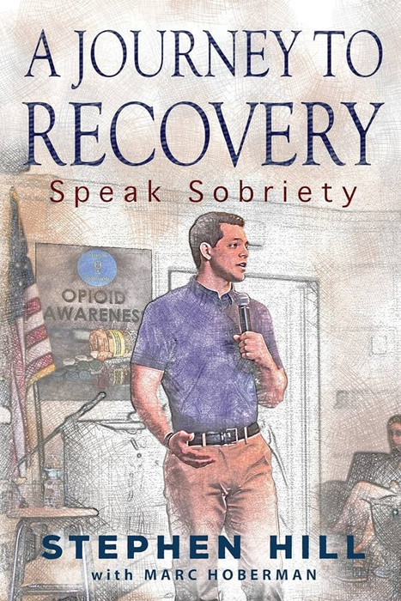

Transforming Youth Discipline and Justice with Restorative Practices
Protective Factors
  School
  Sports/Activities
  Support System
  Parental Supervision
  Positive Peers/Friends
  Mentors/Role Models
  Positive Attitude, Self-esteem & Self-Confidence
  Resilience/Coping Skills
Stephen Hill
While punishment may provide a temporary deterrent, it often falls short in addressing the underlying issues that lead youth astray. Instead of solely penalizing mistakes, let us focus on guiding and supporting our youth, understanding that true transformation arises from education, empathy, and opportunities for growth.
Punitive Measures
  Detention
  In -School Suspension
  Out-of-School Suspension
  Removal from School Sports/Activities
  Expelled
  Probation
  Incarceration
  Held to a Different Standard

Slide 17

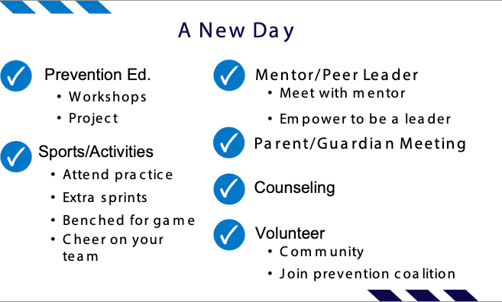



The Restorative Mindset
  OPPORTUNITY - Look at each situation as an opportunity for a teachable moment.
  RELATIONSHIP - How can I use this opportunity to strengthen my relationship with this student/youth?
  INDIVIDUALIZATION - What are the needs of this individual for the particular problem I am trying to solve?
  BUILD CHARACTER - What plan of action can I put into place to build character?
  IMPROVE OUTCOMES - What protective factors can I add in this young person’s life to improve future outcomes?

Slide 18
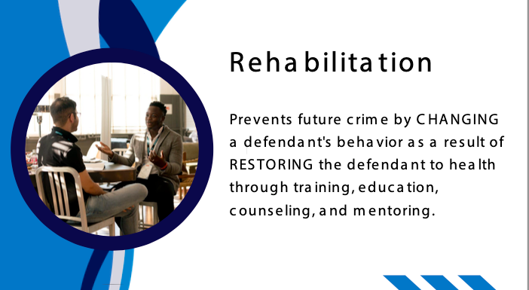

Slide 19


